Slide 1





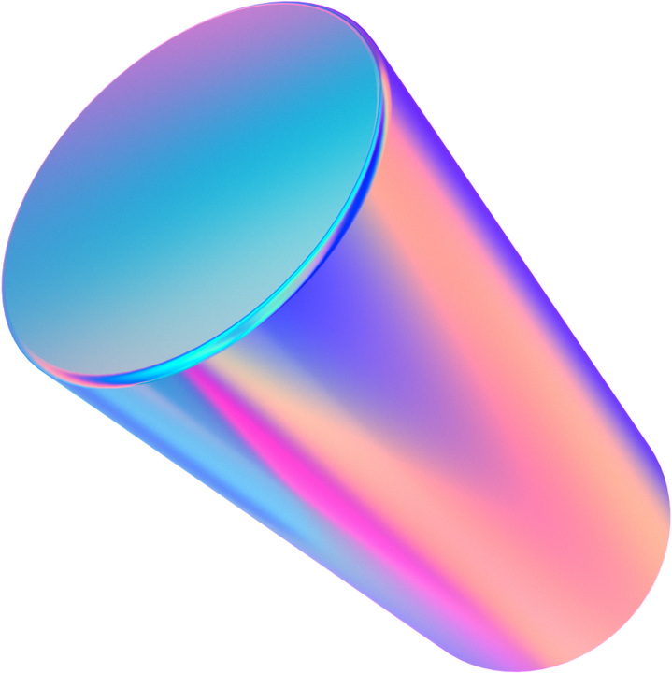
Milestone 1:
Health Monitoring App
Group 3: Alexandra Anthony, Sara Gaber, Ahmad Shah, Neeti Mistry, & Sohan Chatterjee
Notes:
Alex: 1:2:13:14
Ahmad: 3:4
Sara: 5:6:7
Neeti: 8:9:10
Sohan: 11:12

Slide 2
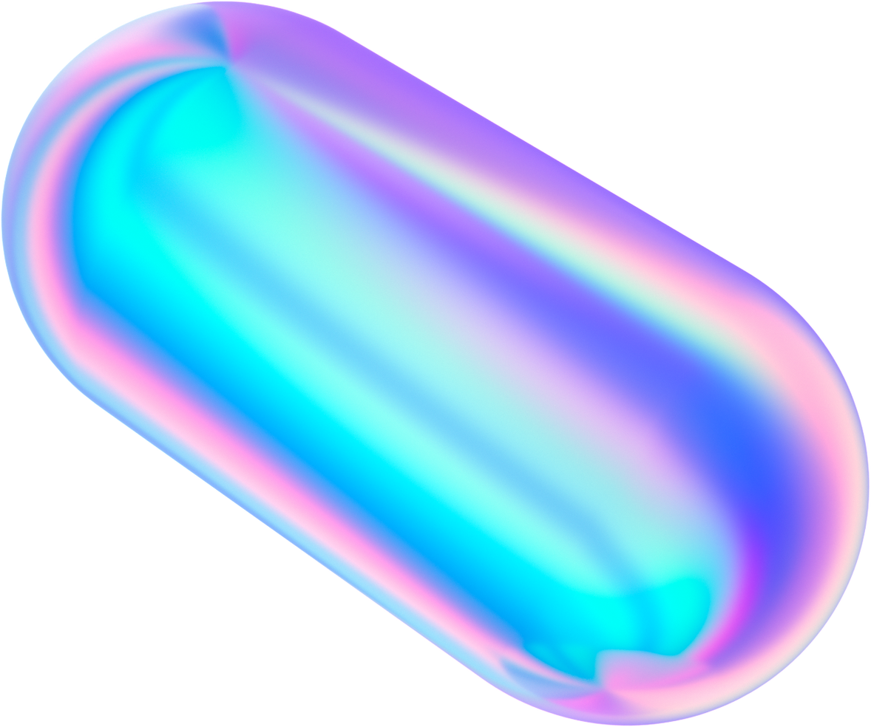
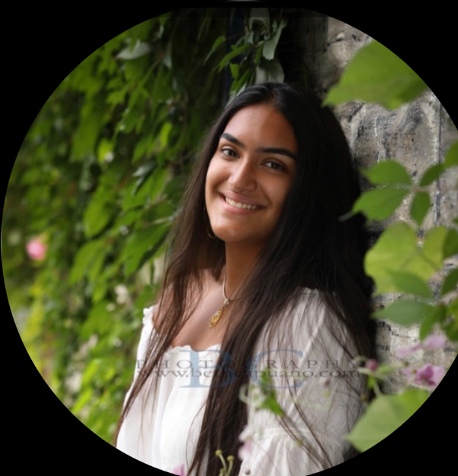
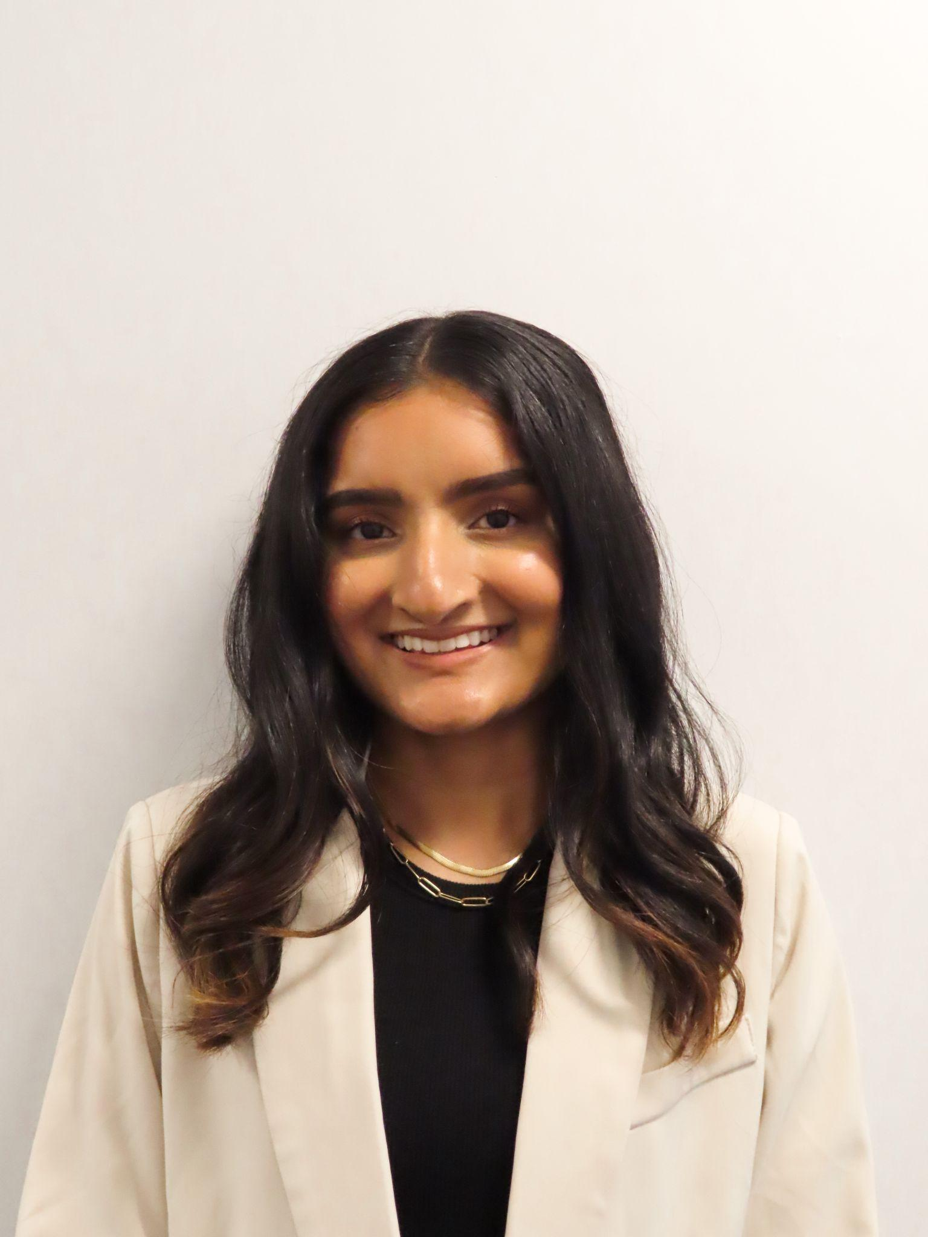
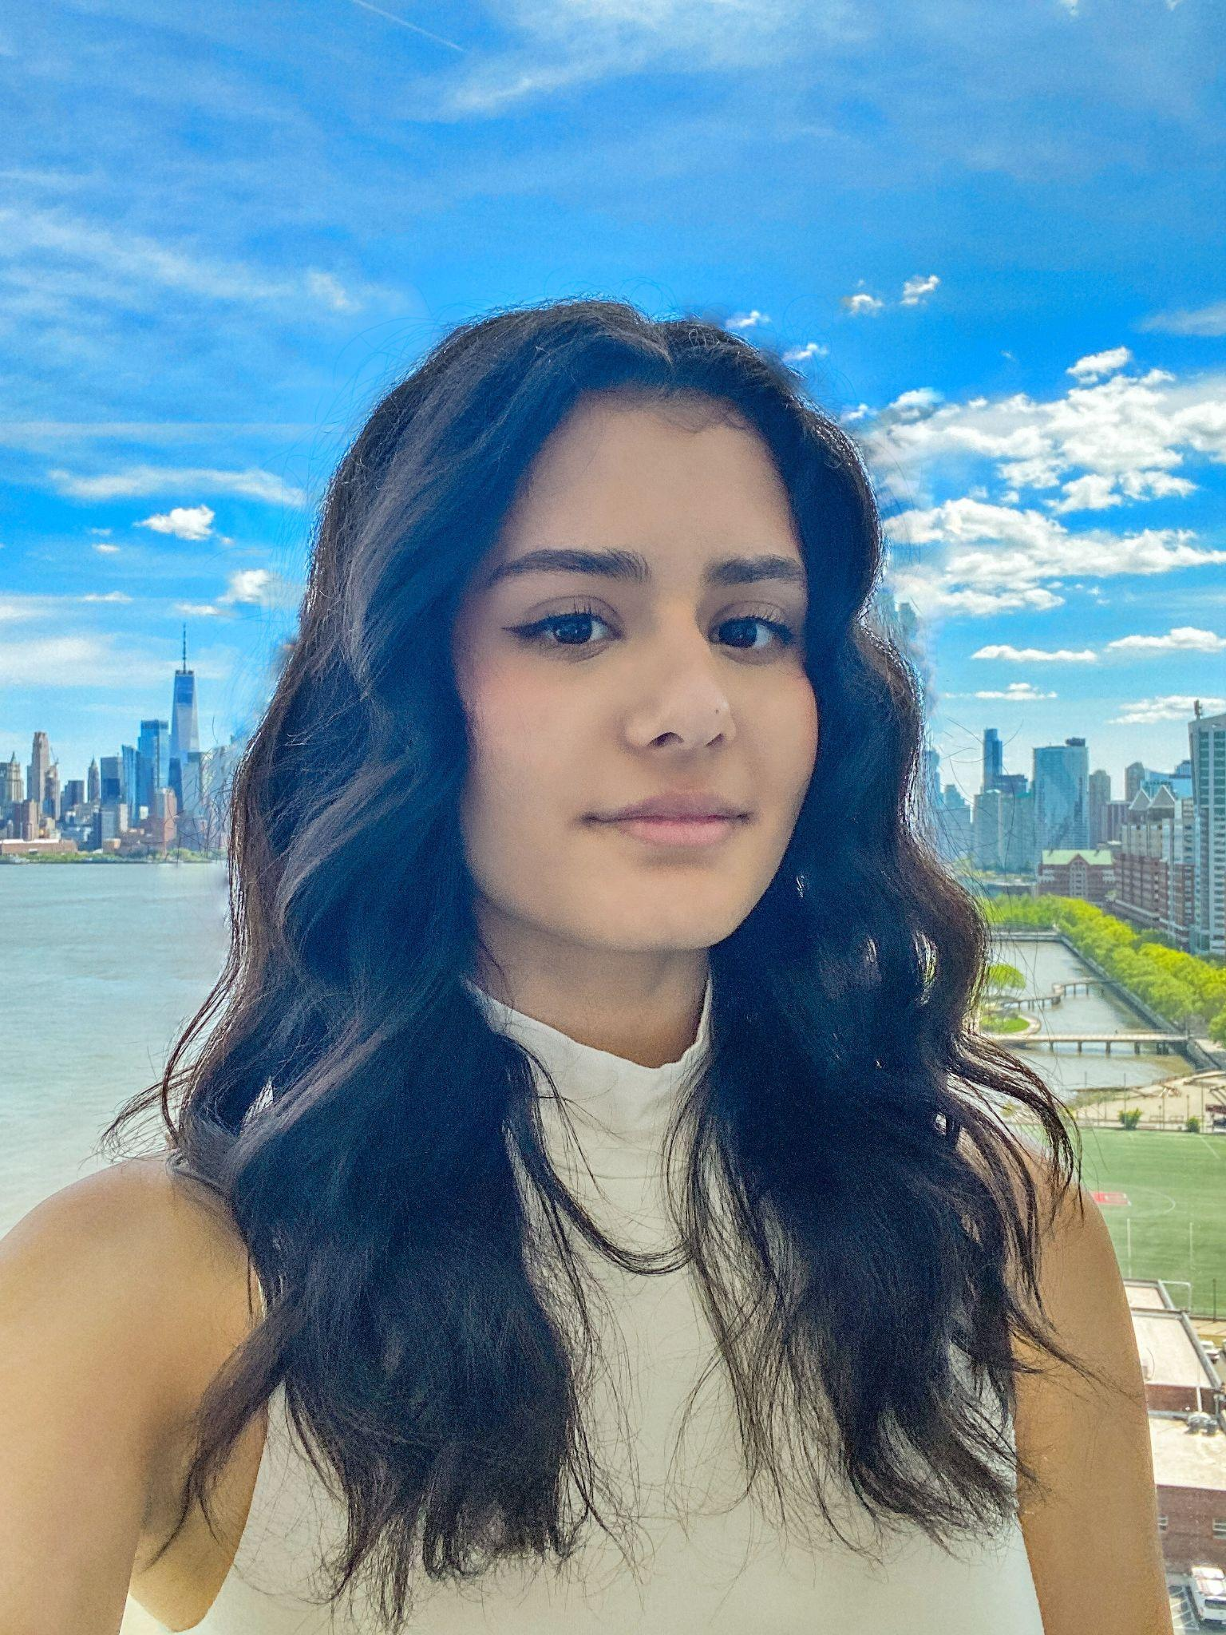
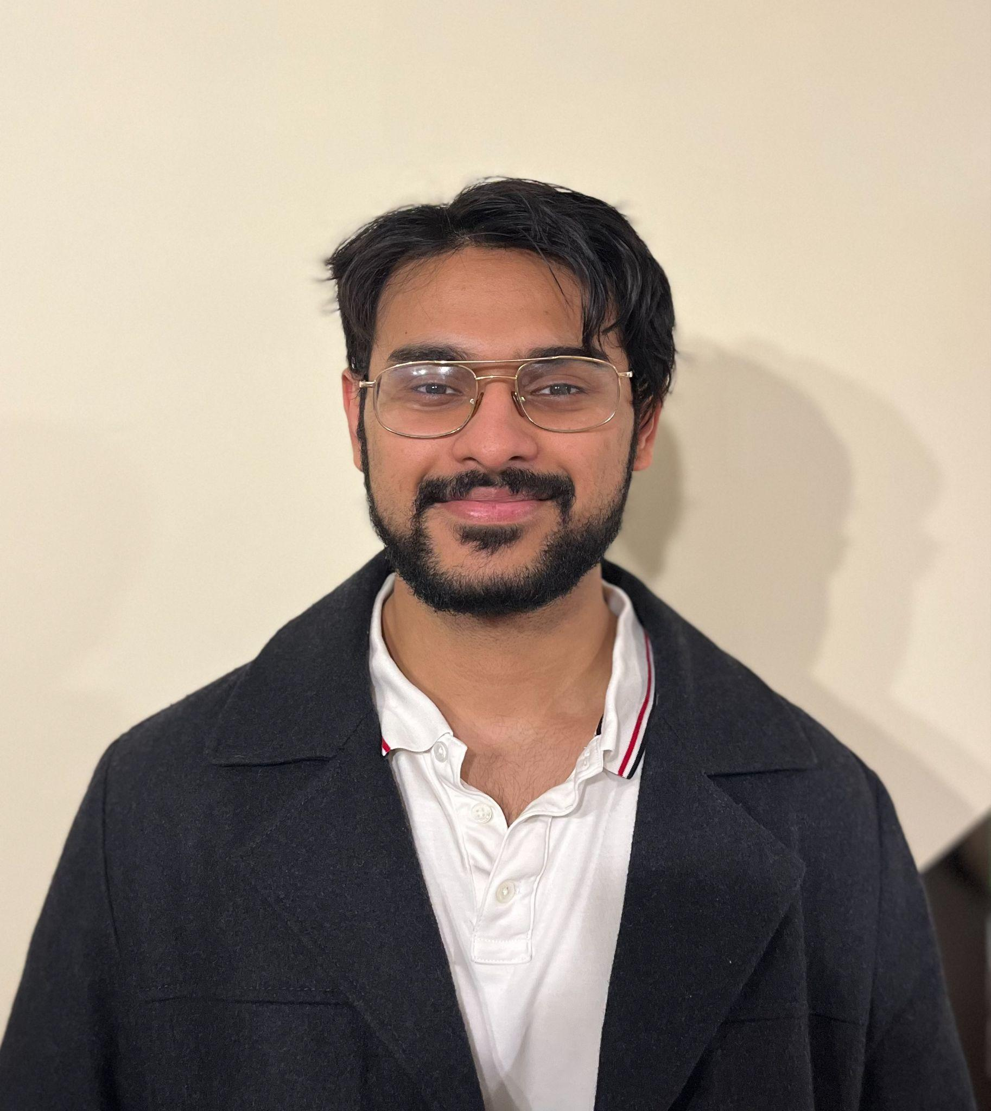

Team Members Intro and Roles
Alex
Neeti
Sara
GitHub Manager & Paper Prototyping Task Management
Slides Presentation Manager & Usability Testing
Paper Prototyping Visual Design
Ahmad
Sohan
Paper Prototyping
& Usability Testing
Slides Presentation
& Usability Testing

Slide 3



Paper Prototype
Create user interfaces to enable them to be rapidly designed, simulated, and tested

Slide 4

Paper Prototype
Utilized uizard → app, web, and UI design software
Includes:
Login Page
Home Page
Health Data
Insights
Profile
Doctor Portal
Focus on creative and user friendly UI

Slide 5
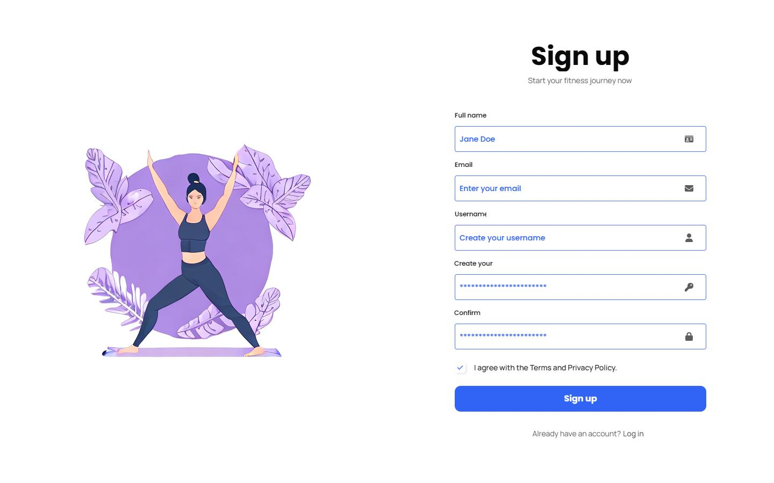
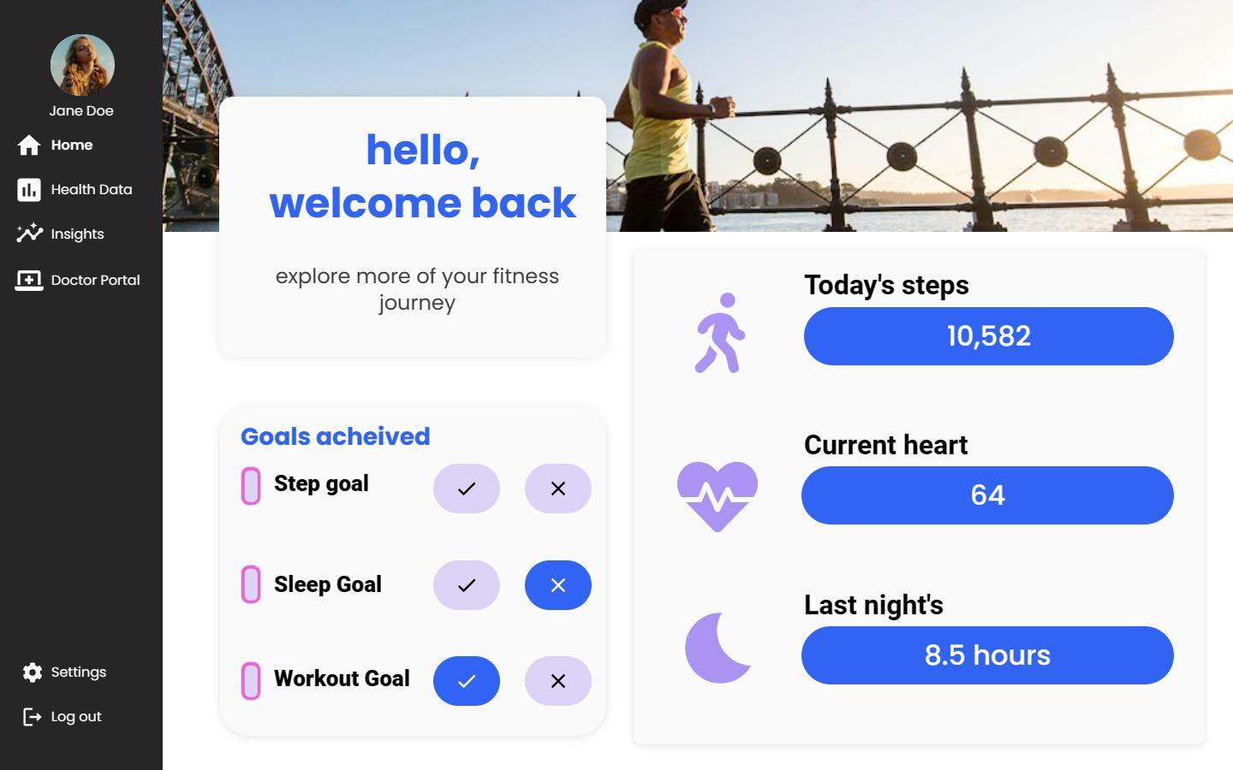

Main Pages
Login and Sign Up Page
Home Page
Login portal to access health account.
Main page for users to navigate to other pages. Can access Profile, Health Data, Insights, Doctor Portal, and view health summary.

Slide 6
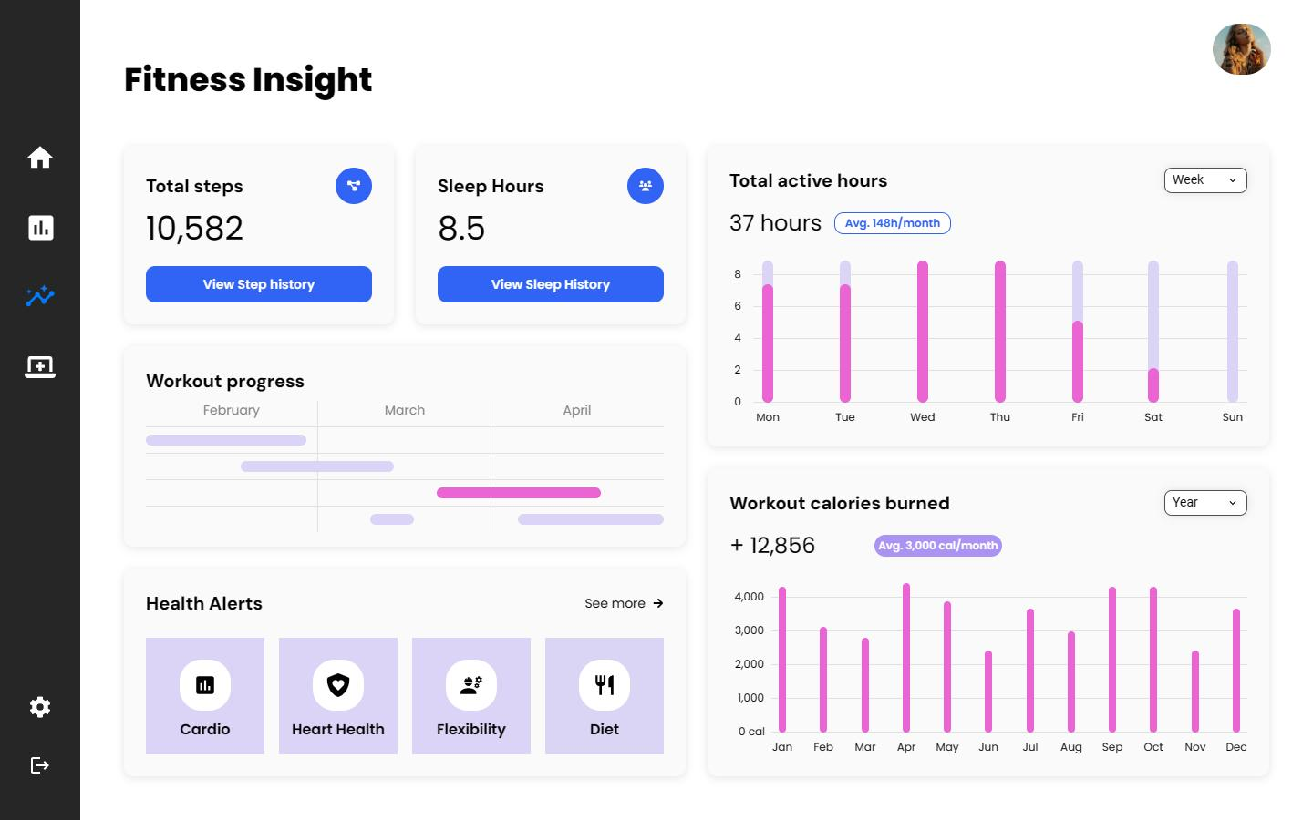
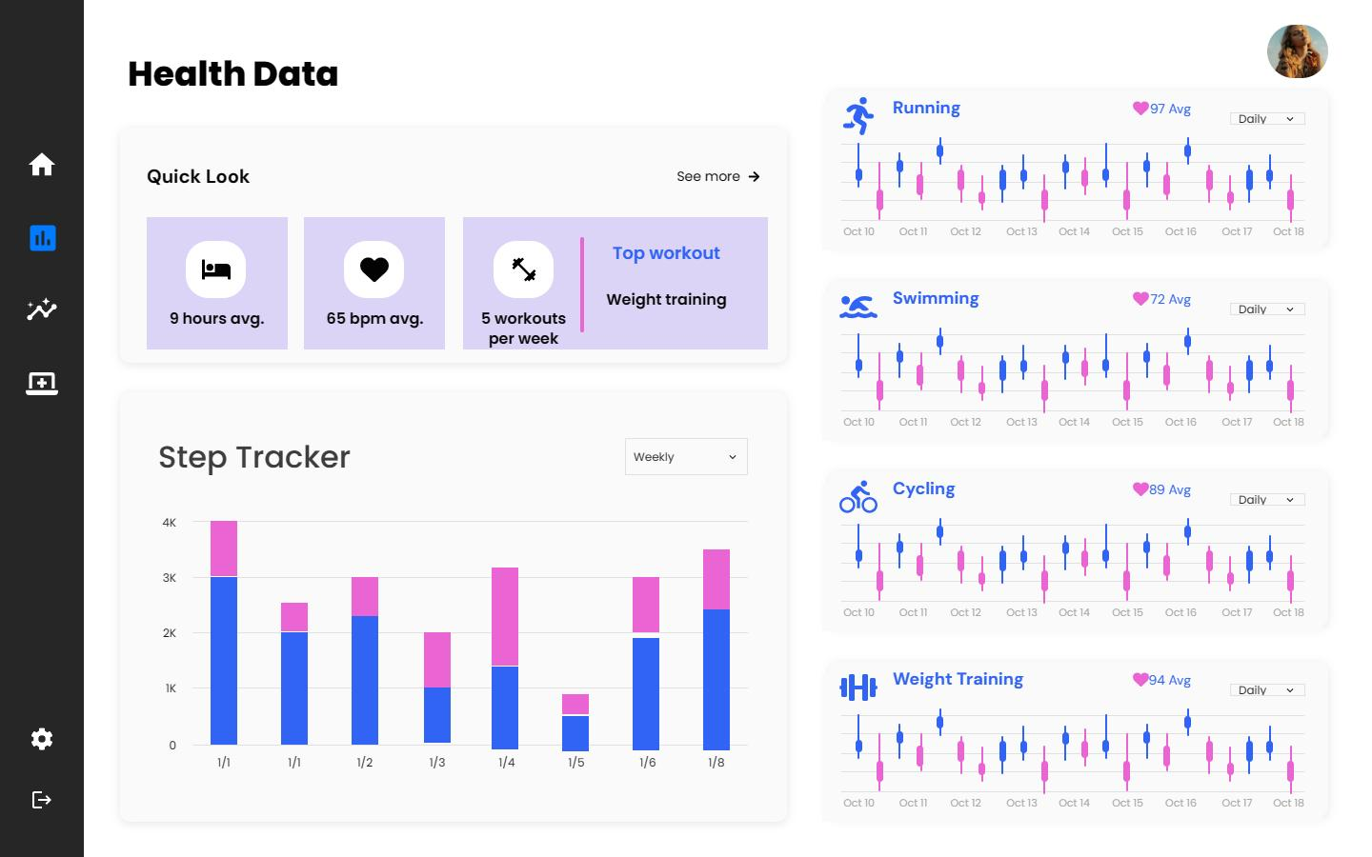
Main Pages
Insights
Health Data
Can view workout, steps, and sleep history. Also gives information on health alerts like possible heart complications.
View all health data and graphs here.

Slide 7
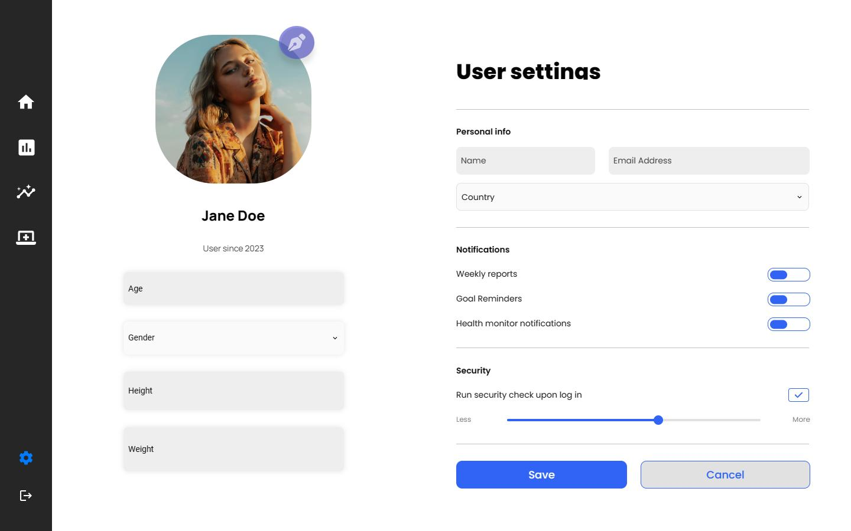
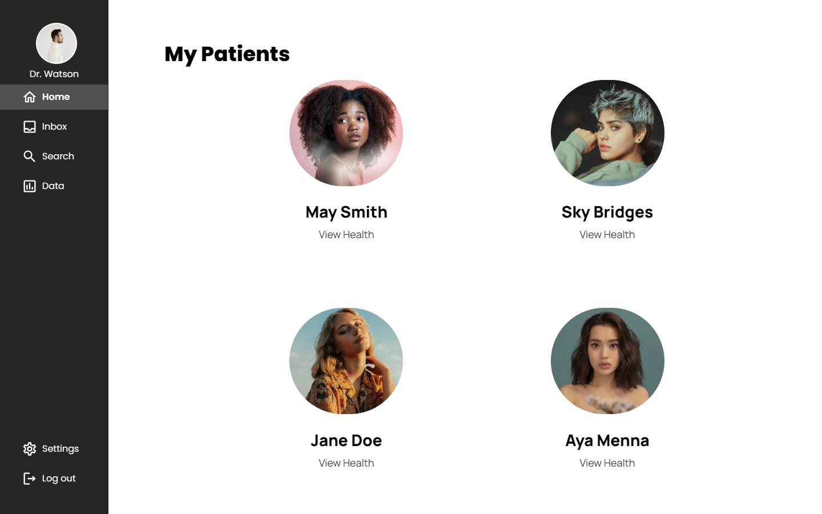
Main Pages
Profile and User Settings
Doctor Portal
Can add user details here, such as name, age, gender, height, and weight. Can also set up notifications.
Doctor can view all patient details and patient history, including health data.

Slide 8


Usability Testing
Testing how actual users interact with the system

Slide 9
Usability Testing
3 Participants
12 minute process (6 minute video)
Ahmad: Facilitator & Human-Computer Interaction
Neeti & Sohan: Observers
Asked participants to accomplish specific tasks on a website
e.g. log in, navigate through pages, edit user profile
Participants were asked to think aloud and test the prototype without any hints

Slide 10
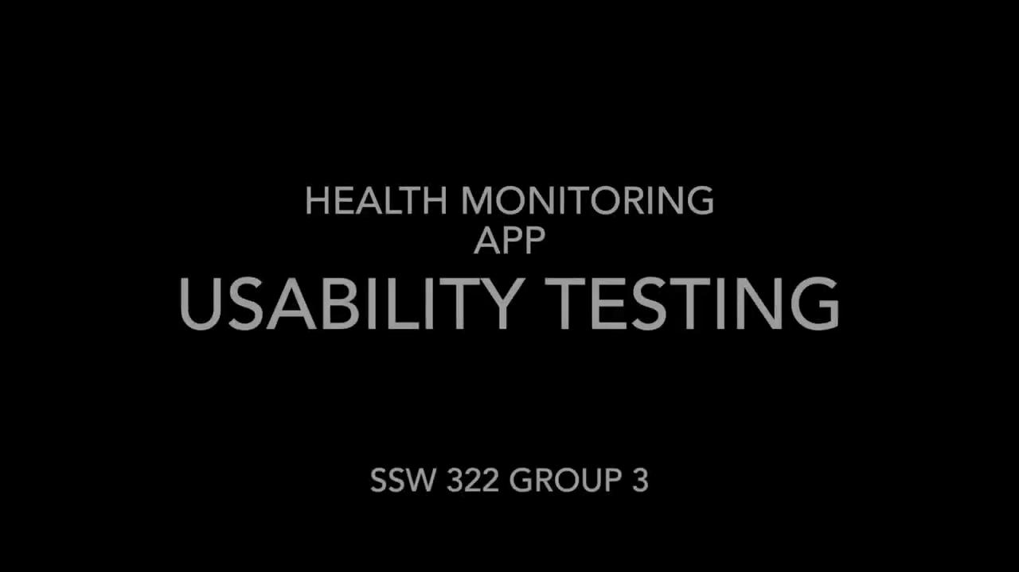
Video Highlights

Slide 11
Summary of Findings
Positives
Navigation bar is user-friendly and self-explanatory
UI is “modern and sleek”
Website is visually appealing and easy to use
Data gathered and shown is useful to users

Slide 12
Summary of Findings
Future Improvements
Add a registration page and a forgot password option
Add navigation bar on other pages besides home page
Make cancel option easier to find on edit profile page
Differentiate edit profile and settings
Ensure a real purpose for connecting to healthcare professionals rather than adding it for the sake of a feature
Users may have privacy concerns about sharing their data if it’s not actually useful

Slide 13

Updated Usability Test (post presentation)
https://youtu.be/DBgfi25QUYc
Notes:
https://www.youtube.com/watch?v=DBgfi25QUYc&feature=youtu.be&themeRefresh=1

Slide 14
Summary of Findings
Positives
Site is Visually Appealing and Intuitive
Overall good feedback regarding the updates made based on previous feedback
Negatives
Users wanted the taskbar to be more clear

Slide 15
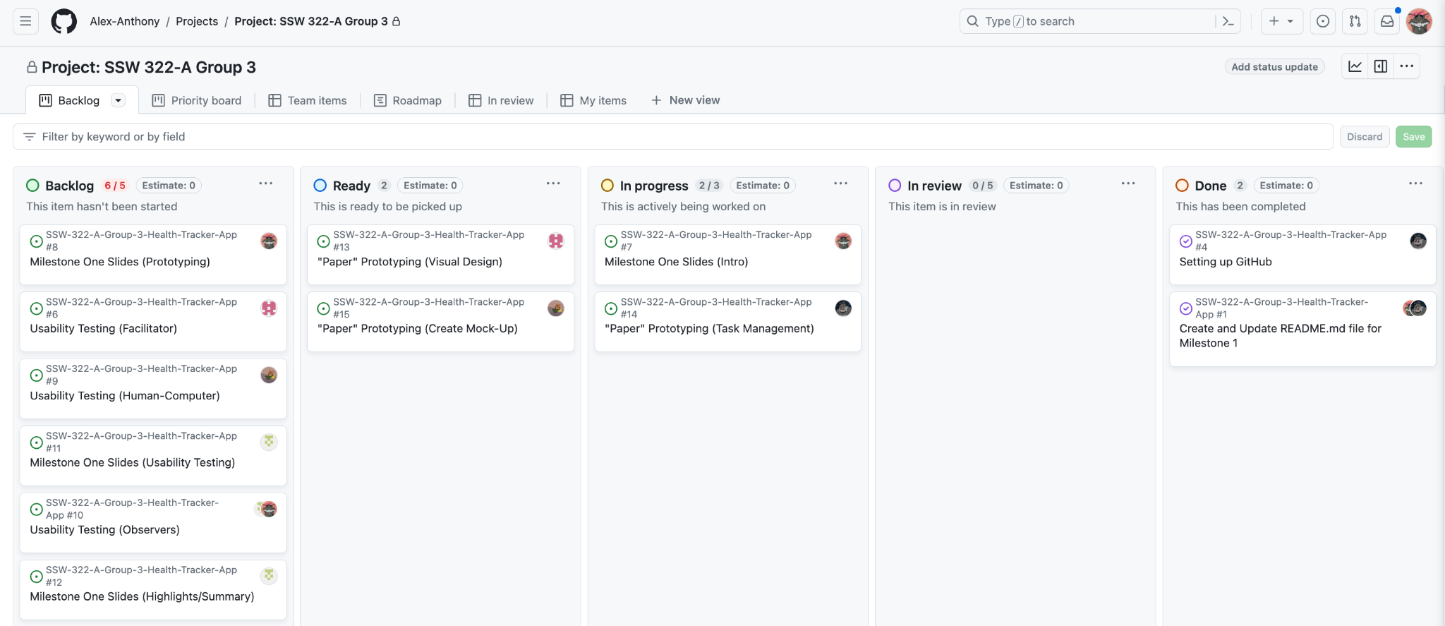
GitHub Dashboard Setup

Slide 16





Thank you!
Any Questions?

